Slide 1
Modelling Integrated Strategies for Multiple Diseases
Lisa White, Caroline Franco and Sheetal Silal
University of Oxford and University of Cape Town

Slide 2
When should a health system turn the corner from vertical to horizonal?
Vertical systems are in place within national public health systems, research and donor communities for high burden diseases (e.g. Plasmodium falciparum malaria)
As vertical systems begin to show impact, the contribution of these diseases to the general morbidity burden is reduced
At this stage these formerly high burden diseases may be viewed as part of a larger ecosystem (e.g. febrile illness, respiratory diseases, etc)

Slide 3
Expect, explore and exploit interactions within and between groupings
Infrastructure
Medicine quality
Treatment
Diagnostics
Antimicrobial resistance
Integrated
cost-effective strategy design
Symptoms
Reservoir
Known aetiology
Vector

Slide 4
Different perspectives on grouping infections
Patient perspectives would lead to a syndromic grouping based on symptoms
Primary healthcare perspectives would lead to grouping by appropriate treatment
Control programs may group diseases by routes of transmission (vector borne, environmental or animal reservoir, etc.) due to similarities in the logistics of intervention at the population level
For new health technology developers (pharma or NGO) the grouping would depend on the primary reason for the deployment of these tools (DX, TX, etc): treatment, monitoring and surveillance, outbreaks, AMR, etc

Slide 5
Example: P. falciparum and P. vivax malaria
Infrastructure
Medicine quality
Treatment
Diagnostics
Antimicrobial resistance
Integrated
cost-effective strategy design
Symptoms
Reservoir
Known aetiology
Vector

Slide 6
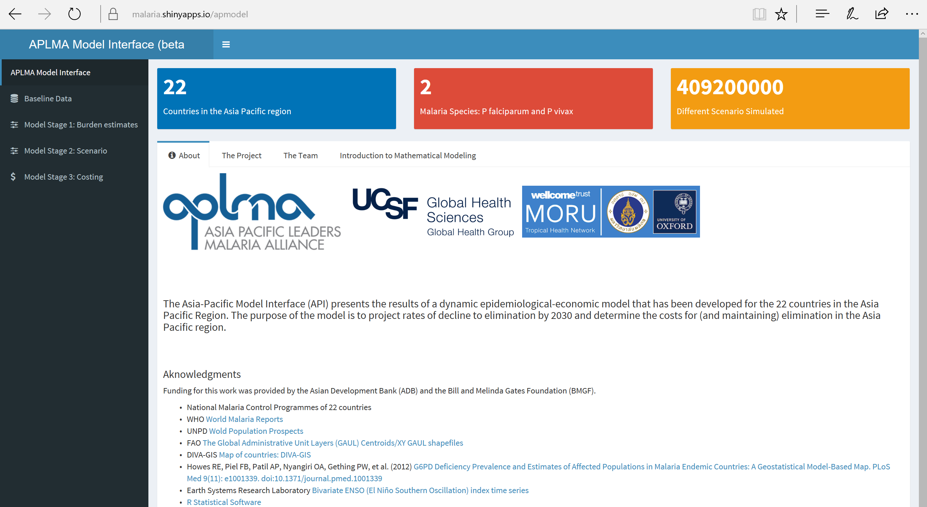
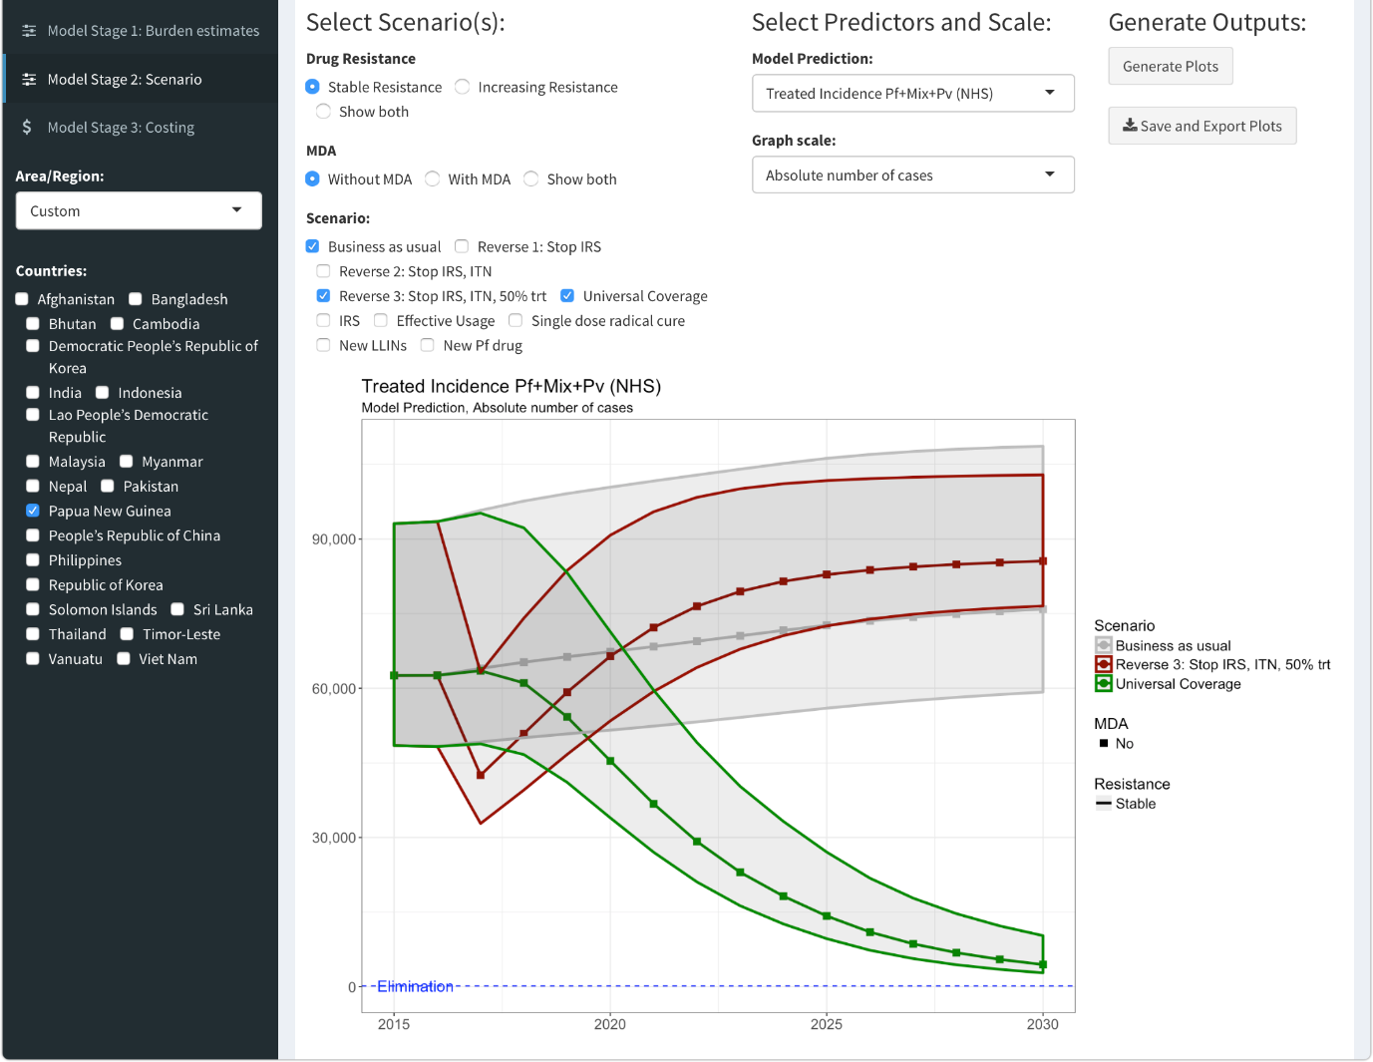
Example: P. falciparum and P. vivax malaria
http://www.metcapmodel.net/

Slide 7






The theory
$$ω$$
$$x$$
$$y$$
$$z$$
$$βy$$
$$ν$$
Consider the SIRS model
Sufficiently general to explore the concept
NB SIRS is NOT appropriate for malaria of any species

Slide 8
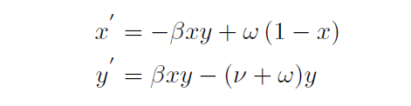
Dimension reduction
$$ω$$
$$x$$
$$y$$
$$z$$
$$βy$$
$$ν$$
Consider the SIRS model
3 equations

Slide 9












Dimension reduction
$$ω_{1}$$
$$x_{1}$$
$$y_{1}$$
$$z_{1}$$
$$β_{1}y_{1}$$
$$ν_{1}$$
Consider the SIRS model
3 equations
Consider two species
$$x_{2}$$
$$β_{2}y_{2}$$
$$ω_{2}$$
$$y_{2}$$
$$ν_{2}$$
$$z_{2}$$

Slide 10



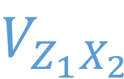

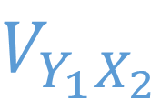



Dimension reduction
$$ω_{1}$$
$$x_{1}$$
$$y_{1}$$
$$z_{1}$$
$$β_{1}y_{1}$$
$$ν_{1}$$
Consider the SIRS model
3 equations
Consider two species
3² Equations
$$x_{2}$$
$$V_{X_{1}X_{2}}$$
$$V_{Y_{1}X_{2}}$$
$$V_{Z_{1}X_{2}}$$
$$β_{2}y_{2}$$
$$ω_{2}$$
$$y_{2}$$
$$V_{X_{1}Y_{2}}$$
$$V_{Y_{1}Y_{2}}$$
$$V_{Z_{1}Y_{2}}$$
$$ν_{2}$$
$$z_{2}$$
$$V_{X_{1}Z_{2}}$$
$$V_{Y_{1}Z_{2}}$$
$$V_{Z_{1}Z_{2}}$$

Slide 11
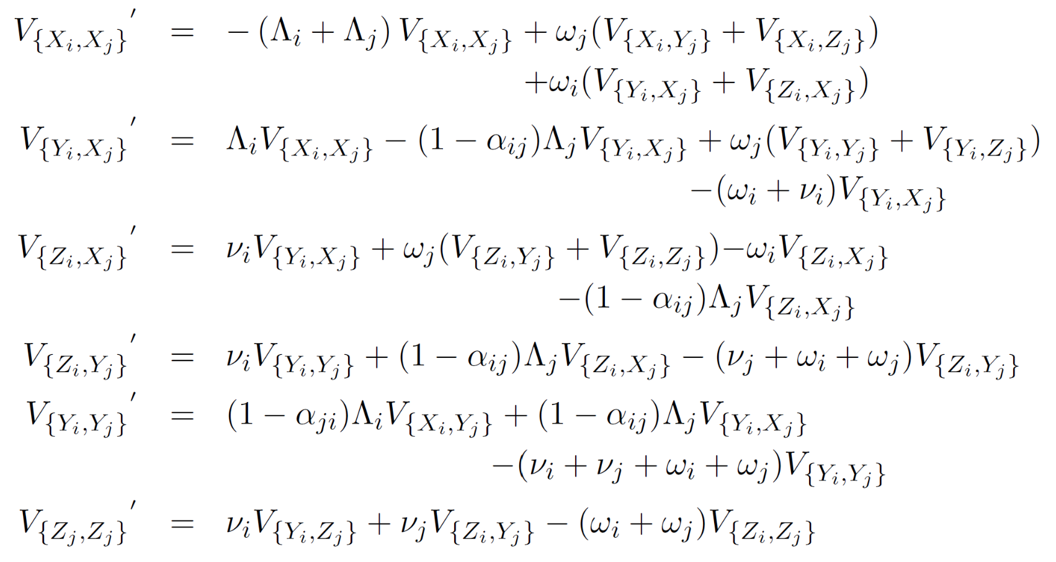
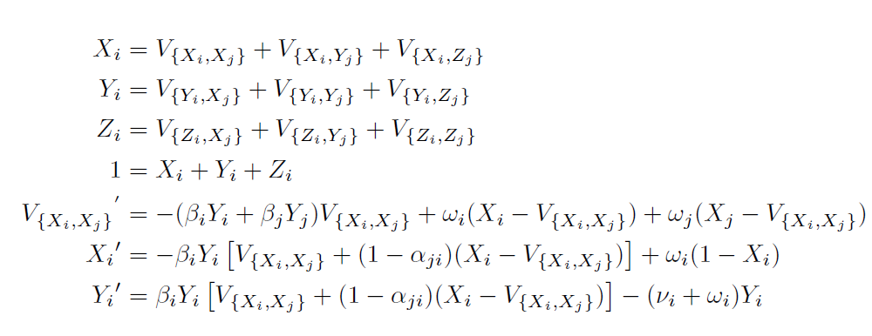
Dimension reduction
$V_{{\{X}_{i,}X_{j}\}} =V_{{ \{X}_{j}X_{i}\}} , V_{{\{Y}_{i,}Y_{j}\}}=V_{{\{Y}_{j,}Y_{i}\}}$,$V_{{\{Z}_{i,}Z_{j}\}}=V_{{\{Z}_{j,}Z_{i}\}}$
Consider the SIRS model
3 equations
Consider two species
3² Equations
Simplify the full model

Slide 12

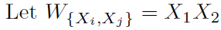
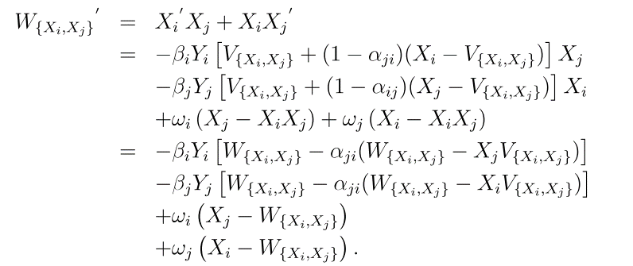

Dimension reduction
Consider the SIRS model
3 equations
Consider two species
3² Equations
Simplify the full model
Compare with the proposed approximation
2x3 Equations
Compare terms of $W_{\left\{X_{i},X_{j}\right\}}^{′}$ and $V_{\left\{X_{i},X_{j}\right\}}^{′}$ to see that $W_{\left\{X_{i},X_{j}\right\}}→V_{\left\{X_{i},X_{j}\right\}}$ as $α_{ij}→0$ and/or $β_{i}→0$

Slide 13
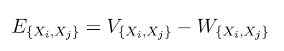
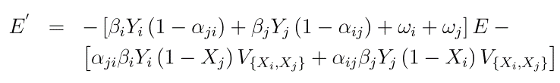
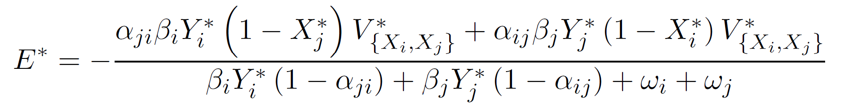
Retrieve the conditions under which the error is small
Light linkage
Low cross-immunity
The error will approach its equilibrium value which is small for light linkage
Short duration of immunity

Slide 14
TRansmission of Related Infections with Light Linkage TRILL approximation

Slide 15
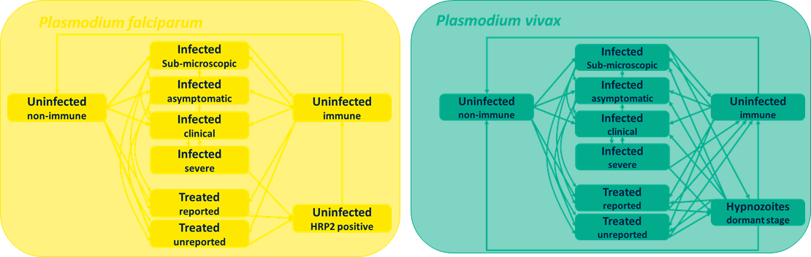
USE CASE: Malaria

Slide 16
Building a malaria model….
Plasmodium falciparum
Plasmodium falciparum
Infected
Sub-microscopic
Infected
asymptomatic
Uninfected
non-immune
Infectious
Uninfected
immune
Uninfected
non-immune
Infected
clinical
Infected
severe
Treated
reported
Uninfected
HRP2 positive
Treated
unreported
individuals may become infected with malaria,

Slide 17
recover naturally and develop immunity
Plasmodium falciparum
Uninfected
non-immune
Infectious
Uninfected
immune

Slide 18
immunity may be lost over time
Plasmodium falciparum
Uninfected
non-immune
Infectious
Uninfected
immune

Slide 19
infections have different levels of severity
Plasmodium falciparum
Infected
Sub-microscopic
Infected
asymptomatic
Uninfected
non-immune
Uninfected
immune
Infected
clinical
Infected
severe

Slide 20
some infections are treated, others recover naturally
Plasmodium falciparum
Infected
Sub-microscopic
Infected
asymptomatic
Uninfected
non-immune
Uninfected
immune
Infected
clinical
Infected
severe
Treated
reported
Treated
unreported

Slide 21
people can still test positive for after successful treatment
Plasmodium falciparum
Infected
Sub-microscopic
Infected
asymptomatic
Uninfected
non-immune
Uninfected
immune
Infected
clinical
Infected
severe
Treated
reported
Uninfected
HRP2 positive
Treated
unreported

Slide 22
immune people get infected, but are less likely to have symptoms
Plasmodium falciparum
Infected
Sub-microscopic
Infected
asymptomatic
Uninfected
non-immune
Uninfected
immune
Infected
clinical
Infected
severe
Treated
reported
Uninfected
HRP2 positive
Treated
unreported

Slide 23
Plasmodium falciparum
Infected
Sub-microscopic
Infected
asymptomatic
Uninfected
non-immune
Uninfected
immune
Infected
clinical
Infected
severe
Treated
reported
Uninfected
HRP2 positive
Treated
unreported
more than one infection at the same time (superinfection)

Slide 24
Plasmodium falciparum
Infected
Sub-microscopic
Infected
asymptomatic
Uninfected
non-immune
Uninfected
immune
Infected
clinical
Infected
severe
Treated
reported
Uninfected
HRP2 positive
Treated
unreported
the model combines all these processes in one framework

Slide 25

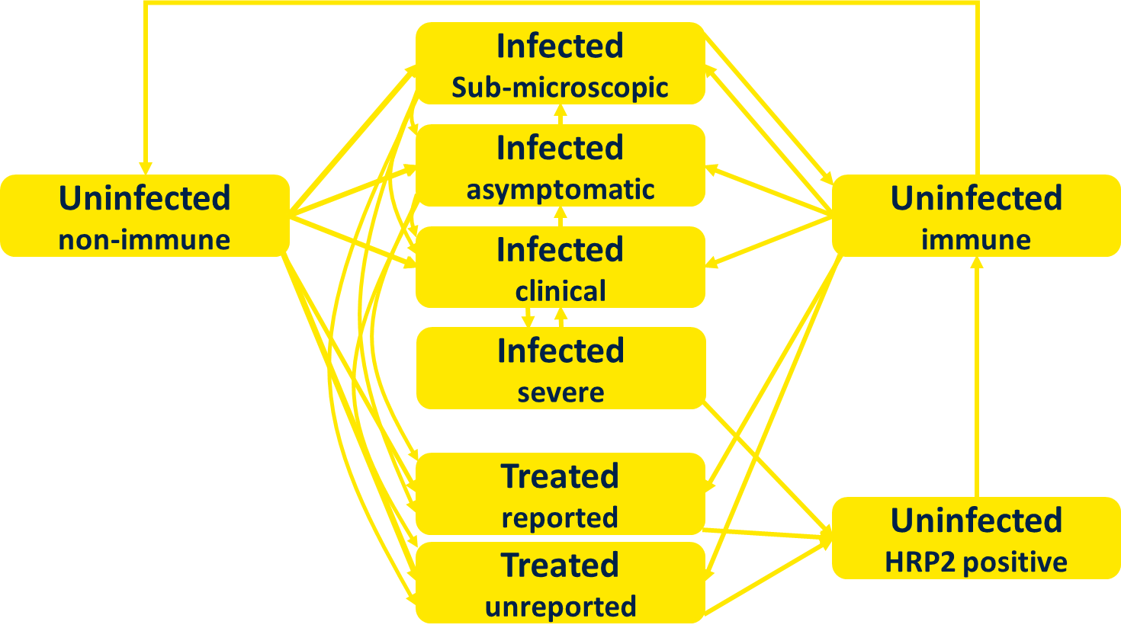
?
Plasmodium falciparum
but the Asia-Pacific has two major malaria species

Slide 26
The model for P. vivax is different from the model for P. falciparum
Plasmodium vivax
Infected
Sub-microscopic
Infected
asymptomatic
Uninfected
non-immune
Uninfected
immune
Infected
clinical
Infected
severe
Treated
reported
Hypnozoites
dormant stage
Treated
unreported

Slide 27
recovery may result in the dormant stage (hypnozoites)
Plasmodium vivax
Infected
Sub-microscopic
Infected
asymptomatic
Uninfected
non-immune
Uninfected
immune
Infected
clinical
Infected
severe
Treated
reported
Hypnozoites
dormant stage
Treated
unreported

Slide 28
hypnozoites are a source of relapse months after the initial infection
Plasmodium vivax
Infected
Sub-microscopic
Infected
asymptomatic
Uninfected
non-immune
Uninfected
immune
Infected
clinical
Infected
severe
Treated
reported
Hypnozoites
dormant stage
Treated
unreported

Slide 29
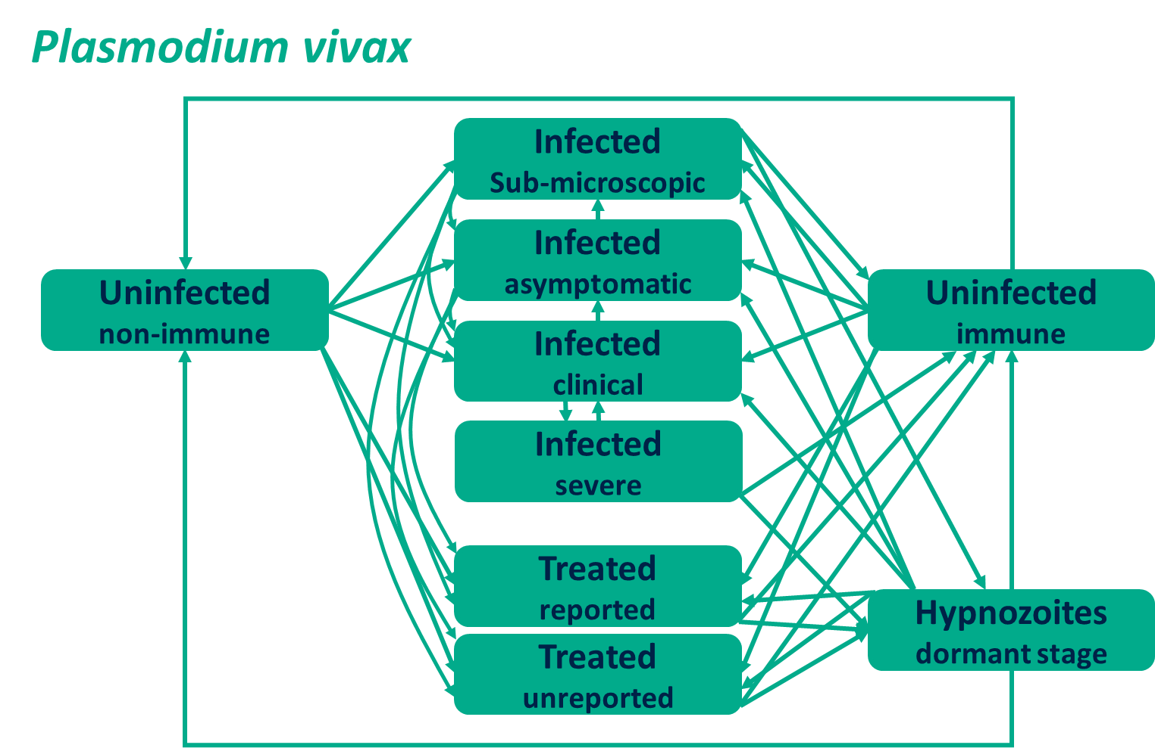
Plasmodium falciparum
the transmission and control of both species is simultaneous

Slide 30
Plasmodium falciparum
Plasmodium vivax
Treatment
Masking
Triggering
the species interact

Slide 31
 |  | Plasmodium falciparum
 |  | Uninfected (non-immune) | Infected (sub-microscopic) | Infected (asymptomatic) | Infected (clinical) | Infected (severe) | Treated (reported) | Treated (unreported) | Uninfected (HRP2) | Uninfected (immune)
Plasmodium vivax | Uninfected (non-immune)
 | Infected (sub-microscopic)
 | Infected (asymptomatic)
 | Infected (clinical)
 | Infected (severe)
 | Treated (reported)
 | Treated (unreported)
 | Hypnozoites
 | Uninfected (immune)
the species interact weakly

Slide 32
USE CASE: Respiratory diseases
COVID-19 morbidly and mortality are now in the range of other reparatory diseases
Immunity to diseases like influenza, RSV etc has declined due to COVID-19 restrictions bringing down natural boosting
Integrated strategies for respiratory diseases may help to reduce the winter burden on UK hospitals
This question is a candidate for the TRILL approximation approach

Slide 33
Impact
Integrated strategies could lead to cost savings and increased health impact
Modelling could be used to develop strategies which involve several interacting diseases or systems
To do this in a tractable way, suitable methodologies must be deployed to reduce the dimension of the model structures
from exponentially increasing to linearly increasing with the number of species
Translation to policy and implementation will be challenging and requires powerful economic arguments messaged in an engaging way

Slide 34

Any questions?

